Slide 1
An examination of hypersexuality and impulsivity in sexual offenders
Katherine Seavey
4/25/2023

Slide 2
Sexual Offending
Heterogeneous group (Robertiello & Terry, 2007)
Targets
Motivations
Tactics
Identify risk factors for specific subgroups
Rapists, incest, extrafamilial child molesters, child sexual exploitation material

Slide 3
Hypersexuality and Impulsivity
Hypersexuality: excessive sexual thoughts that are difficult or impossible to control (Knight & Du, 2021)
Associated with sexual coercion and deviance (Knight & Sims-Knight 2011)
Impulsivity: Tendency to act without thinking and without consideration for consequences
Mixed findings for the association between impulsivity and hypersexuality (Knight & Du, 2021)
Rapists vs child sexual offenders (Browne et al., 2018; Prentky et al., 1989)
Notes:
Hyper sexuality is a broad construct
Includes, but is not limited to excessive sexuality, sexual compulsivity/impulsivity, and sexual addition
Sexual drive and preoccupation found to differentiate between coercive and noncoercive males
Rapists crimes tend to be more impulsive than child sexual offenders’, child molesters less likely to manifest impulsive behavior in school
Not porn vs porn (impulsivity may be less involved in porn use)

Slide 4
The Current Project
Examine the association between hypersexuality and impulsivity in sexual offenders
Differentiated by victim type: rapists, incest, extrafamilial child molesters, child sexual exploitation material offenders
Pure offense type: no mixed offenders
Clustered based on institution where measurement was delivered
Notes:
Differences in hypersexuality
Differences in the association between impulsivity and hypersexuality

Slide 5
Hypotheses
H1: Impulsivity will be significantly positively associated with hypersexuality.
Notes:
Differences in hypersexuality
Differences in the association between impulsivity and hypersexuality

Slide 6
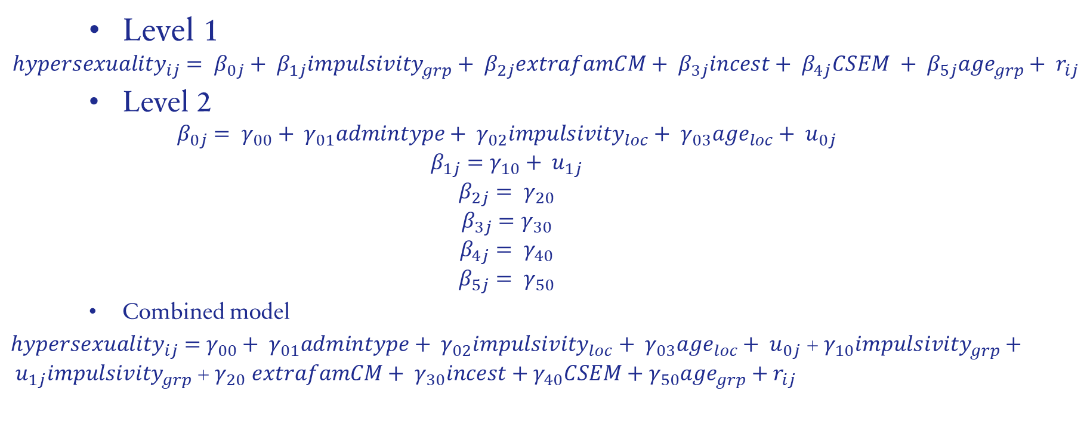
Model
Level 1
$${hypersexuality}_{ij}= β_{0j}+ β_{1j}impulsivity_{grp}+ β_{2j}extrafamCM+ β_{3j}incest+ β_{4j}CSEM + β_{5j}age_{grp}+ r_{ij}$$
Level 2
$$β_{0j}= γ_{00}+ γ_{01}admintype+ γ_{02}impulsivity_{loc}+ γ_{03}age_{loc}+ u_{0j}$$
$$β_{1j}=γ_{10}+ u_{1j}$$
$$β_{2j}= γ_{20}$$
$$β_{3j}=γ_{30}$$
$$β_{4j}= γ_{40}$$
$$β_{5j}= γ_{50}$$
Combined model
${hypersexuality}_{ij}=$ $γ_{00}+ γ_{01}admintype+ γ_{02}impulsivity_{loc}+ γ_{03}age_{loc}+ u_{0j}$ + $γ_{10}impulsivity_{grp}+ u_{1j}impulsivity_{grp}$ + $γ_{20}$ $extrafamCM+ γ_{30}incest+γ_{40}CSEM+γ_{50}age_{grp}+r_{ij}$
Notes:
Differences in hypersexuality
Differences in the association between impulsivity and hypersexuality

Slide 7
Hypotheses
H2: Rapists will show a significantly stronger association between impulsivity and hypersexuality than other offenders.
H3: CSEM offenders will show significantly greater association between impulsivity and hypersexuality than incest offenders and extrafamilial child molesters.
Notes:
Differences in hypersexuality
Differences in the association between impulsivity and hypersexuality

Slide 8
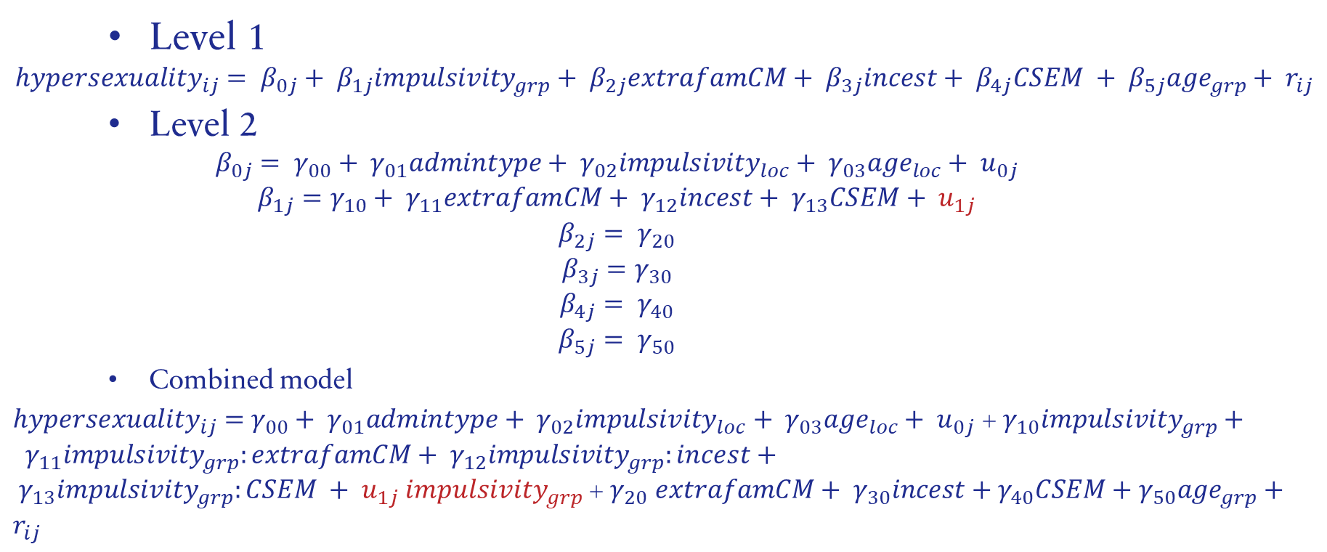
Model
Level 1
$${hypersexuality}_{ij}= β_{0j}+ β_{1j}impulsivity_{grp}+ β_{2j}extrafamCM+ β_{3j}incest+ β_{4j}CSEM + β_{5j}age_{grp}+ r_{ij}$$
Level 2
$$β_{0j}= γ_{00}+ γ_{01}admintype+ γ_{02}impulsivity_{loc}+ γ_{03}age_{loc}+ u_{0j}$$
$$β_{1j}=γ_{10}+ γ_{11}extrafamCM+ γ_{12}incest+ γ_{13}CSEM+ u_{1j}$$
$$β_{2j}= γ_{20}$$
$$β_{3j}=γ_{30}$$
$$β_{4j}= γ_{40}$$
$$β_{5j}= γ_{50}$$
Combined model
${hypersexuality}_{ij}=$ $γ_{00}+ γ_{01}admintype+ γ_{02}impulsivity_{loc}+ γ_{03}age_{loc}+ u_{0j}$ + $γ_{10}impulsivity_{grp}+ γ_{11}impulsivity_{grp}:extrafamCM+ γ_{12}impulsivity_{grp}:incest+ γ_{13}impulsivity_{grp}:CSEM {+ u}_{1j}impulsivity_{grp}$ + $γ_{20}$ $extrafamCM+ γ_{30}incest+γ_{40}CSEM+γ_{50}age_{grp}+r_{ij}$
Notes:
Differences in hypersexuality
Differences in the association between impulsivity and hypersexuality

Slide 9
Methods

Slide 10
Participants
 | M (SD )
Age | 40.2(11.5)
 | Frequency(%)
Research Admin | 272(77.9)
African American | 54(15.5)
Asian | 4(1.1)
White | 246(70.5)
Hispanic | 32(9.2)
Native American | 13(3.7)
Other | 11(3.2)
Rapist | 97(27.8)
Incest | 67(19.2)
Extrafamilial CM | 95(27.2)
CSEM | 90(25.8)
349 men in correctional or clinical settings
Settings with sex offender treatment
Recruited by referral or with fliers
Completed MIDSA in exchange for cash incentive
Administered MIDSA for clinical or research purposes
Mixed offenders removed
Notes:
Original sample size: 529
Define MIDSA

Slide 11
Measures: Level 1
Hypersexuality: Measured with 5 items from the MIDSA
Outcome
Five-point Likert-scale: “0 = definitely false” to “4 = definitely true”
One question about preferred frequency of sex
“I sometimes think about sex so much that it gets on my nerves.”
Impulsivity: Measured with 7 items from MIDSA (Knight & Guay, 2006)
Five-point Likert-scale: “0 = definitely false” to “4 = definitely true”
“I do things that make me feel really bad about myself.”
Group mean centered
Notes:
Differences in hypersexuality
Differences in the association between impulsivity and hypersexuality

Slide 12
Measures: Level 1
Sex offense type: rapist, incest, extrafamilial child molester, child sexual exploitation material
Child offenses against individuals younger than 16
Based on records
Dummy coded variables created, rapist set as reference
Age: Covariate
Group mean centered
Notes:
Differences in hypersexuality
Differences in the association between impulsivity and hypersexuality

Slide 13
Measures: Level 2
Administration type: clinical or research
Research coded as 1
Group mean variables: impulsivity, age
Clustering variable: administration location
7 locations
Varied by type of institution
Varied by region in U.S.
Notes:
Differences in hypersexuality
Differences in the association between impulsivity and hypersexuality

Slide 14
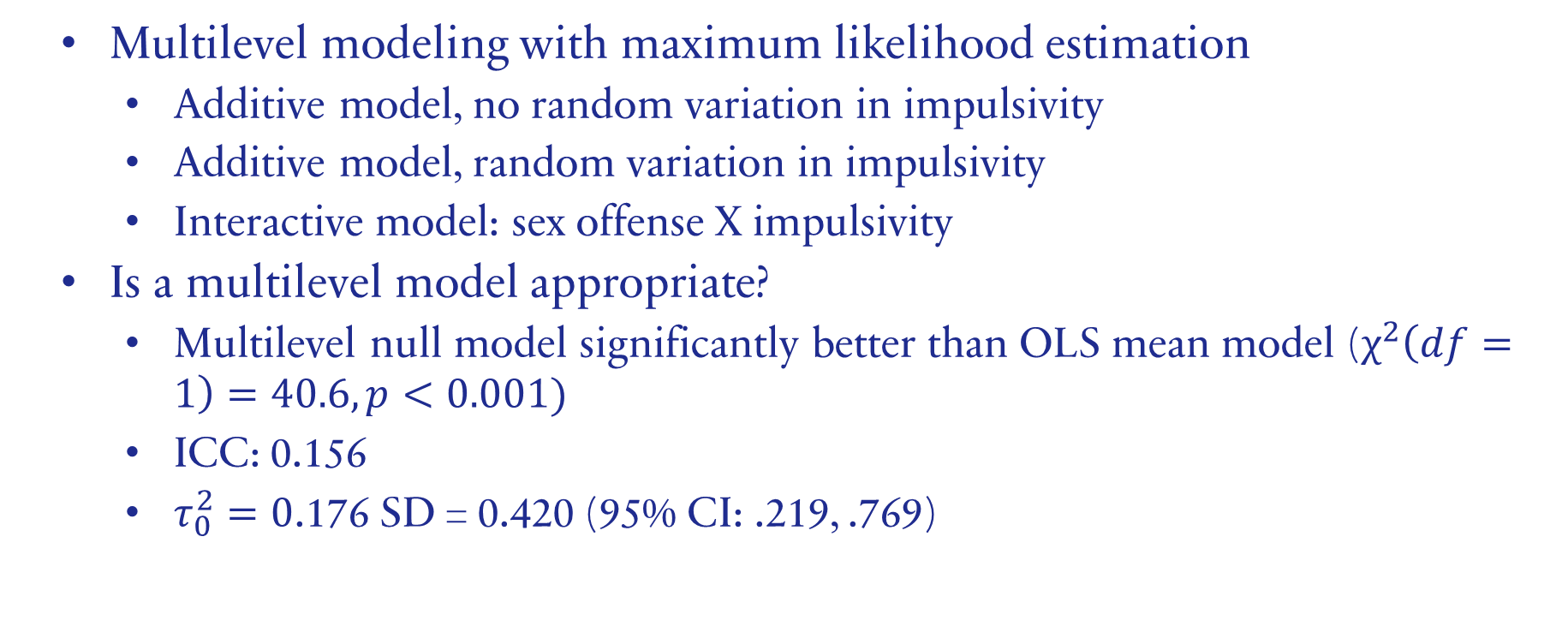
Analyses
Multilevel modeling with maximum likelihood estimation
Additive model, no random variation in impulsivity
Additive model, random variation in impulsivity
Interactive model: sex offense X impulsivity
Is a multilevel model appropriate?
Multilevel null model significantly better than OLS mean model ($χ^{2}\left(df=1\right)=40.6, p<0.001)$
ICC: 0.156
$τ_{0}^{2}=0$.176 SD = 0.420 (95% CI: .219, .769)
Notes:
ICC: .156 total variation accounted for by between-school factors

Slide 15
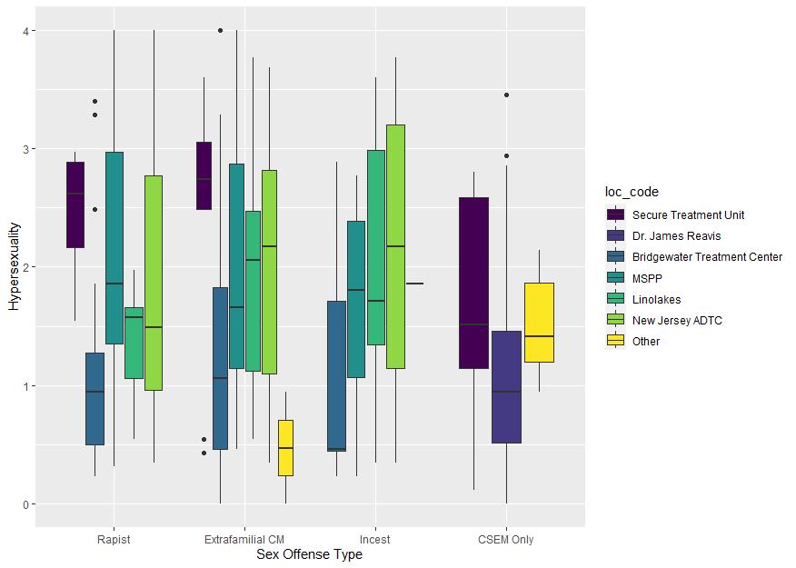
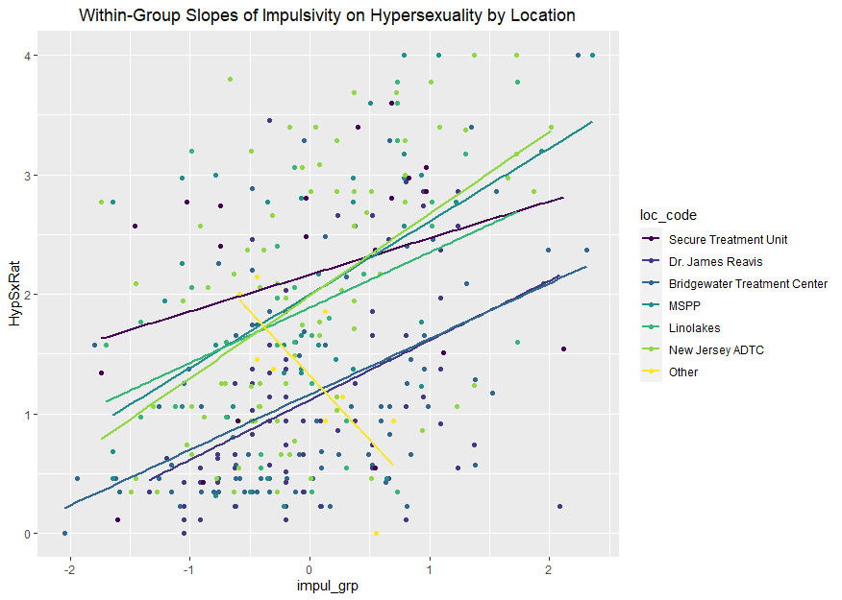
Analyses
Multilevel modeling
Significant variation between groups
Notes:
Differences in hypersexuality
Differences in the association between impulsivity and hypersexuality

Slide 16
Results

Slide 17
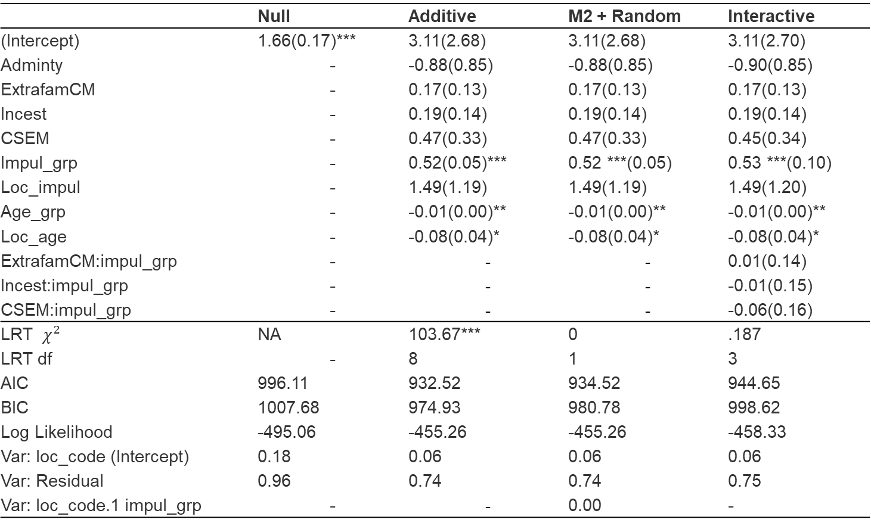
Model Results
 | Null | Additive | M2 + Random | Interactive
(Intercept) | 1.66(0.17)*** | 3.11(2.68) | 3.11(2.68) | 3.11(2.70)
Adminty | - | -0.88(0.85) | -0.88(0.85) | -0.90(0.85)
ExtrafamCM | - | 0.17(0.13) | 0.17(0.13) | 0.17(0.13)
Incest | - | 0.19(0.14) | 0.19(0.14) | 0.19(0.14)
CSEM | - | 0.47(0.33) | 0.47(0.33) | 0.45(0.34)
Impul_grp | - | 0.52(0.05)*** | 0.52 ***(0.05) | 0.53 ***(0.10)
Loc_impul | - | 1.49(1.19) | 1.49(1.19) | 1.49(1.20)
Age_grp | - | -0.01(0.00)** | -0.01(0.00)** | -0.01(0.00)**
Loc_age | - | -0.08(0.04)* | -0.08(0.04)* | -0.08(0.04)*
ExtrafamCM:impul_grp | - | - | ­- | 0.01(0.14)
Incest:impul_grp | - | - | - | -0.01(0.15)
CSEM:impul_grp | - | - | - | -0.06(0.16)
LRT $χ^{2}$ | NA | 103.67*** | 0 | .187
LRT df | - | 8 | 1 | 3
AIC | 996.11 | 932.52 | 934.52 | 944.65
BIC | 1007.68 | 974.93 | 980.78 | 998.62
Log Likelihood | -495.06 | -455.26 | -455.26 | -458.33
Var: loc_code (Intercept) | 0.18 | 0.06 | 0.06 | 0.06
Var: Residual | 0.96 | 0.74 | 0.74 | 0.75
Var: loc_code.1 impul_grp | - | - | 0.00 | -
*p < .05 **p < .01 ***p < .001
Notes:
Likelihood ratio test

Slide 18
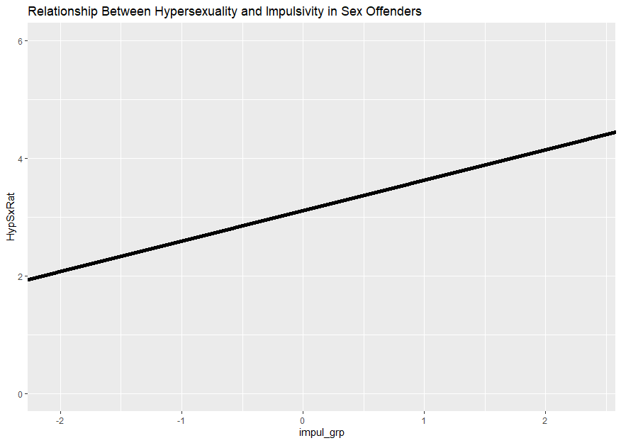

Model 1: Significant effects
Age: ${\hat{γ}}_{age_grp}=−0.01, 95\% CI:−0.02, −0.004$
Impulsivity: ${\hat{γ}}_{impul_grp}=0.52, 95\% CI:0.41, 0.62$
Proportion of variance reduction due to impulsivity: 0.207
Notes:
Within each institution, participants’ impulsivity is positively related to their hypersexuality.
Averaged over institutions, the slope of impulsivity is…

Slide 19
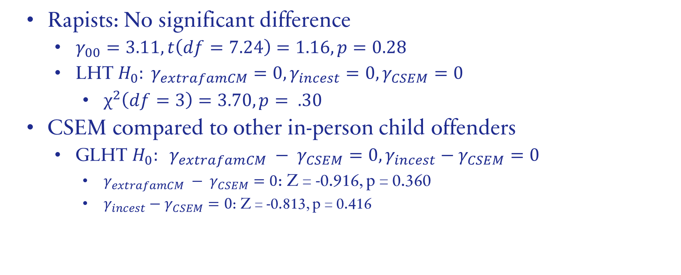
Offender Type
Rapists: No significant difference
$γ_{00}=3.11, t\left(df=7.24\right)=1.16, p=0.28$
LHT $H_{0}: γ_{extrafamCM}=0, γ_{incest}=0, γ_{CSEM}=0$
$χ^{2}\left(df=3\right)=3.70, p= .30$
CSEM compared to other in-person child offenders
GLHT $H_{0}: γ_{extrafamCM} − γ_{CSEM}=0, γ_{incest}−γ_{CSEM}=0$
$γ_{extrafamCM} − γ_{CSEM}=0$: Z = -0.916, p = 0.360
$γ_{incest}−γ_{CSEM}=0$: Z = -0.813, p = 0.416
Notes:
SD is significant
Linear hypothesis test

Slide 20
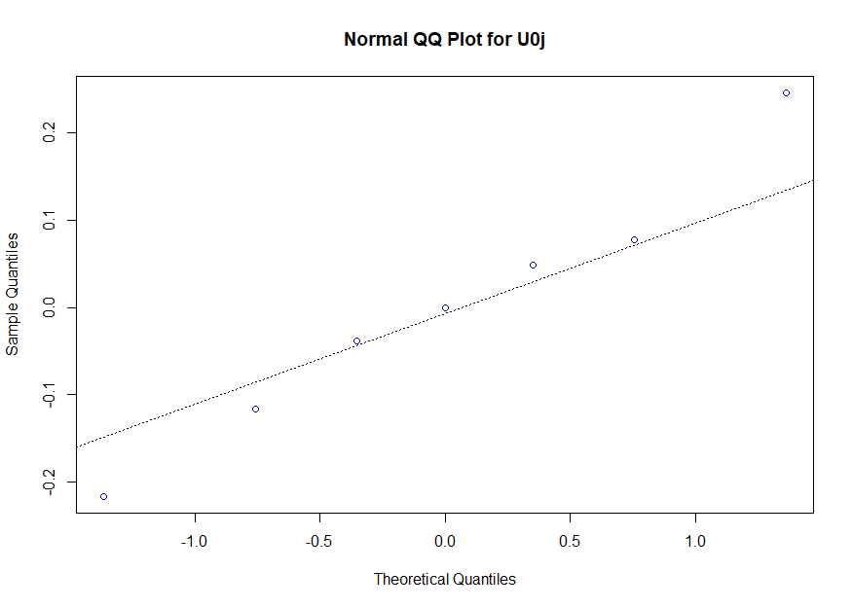
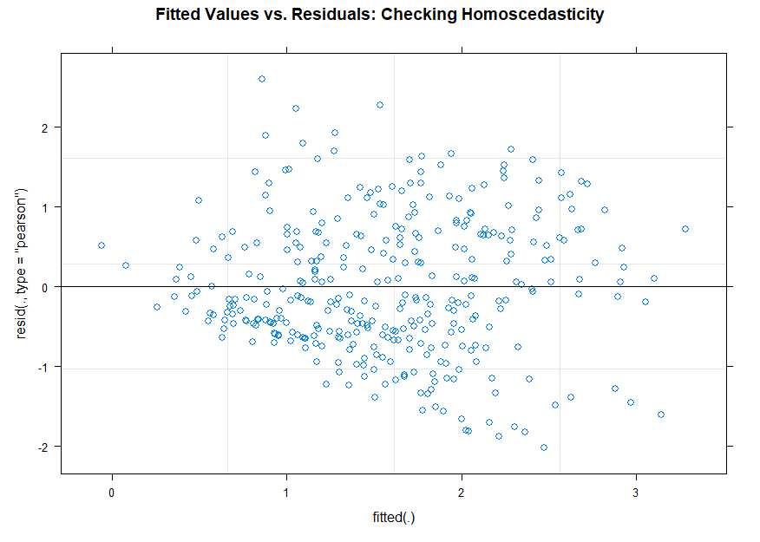
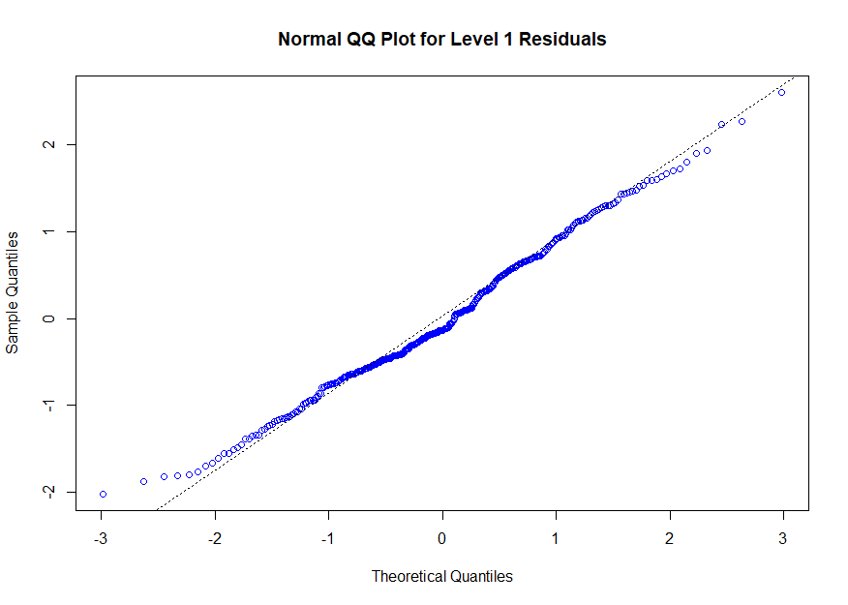
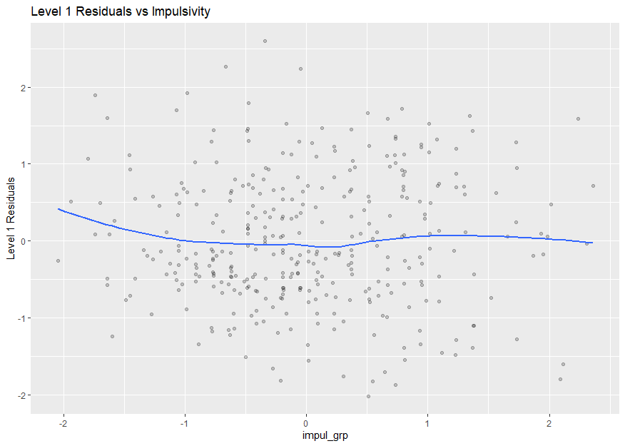
Residuals look good!

Slide 21
Discussion

Slide 22
Summary
H1: Impulsivity will be significantly positively associated with hypersexuality.
Supported
H2: Rapists will show a significantly stronger association between impulsivity and hypersexuality than other offenders.
Not supported
H3: CSEM offenders will show significantly greater association between impulsivity and hypersexuality than incest offenders and extrafamilial child molesters.
Not supported
Notes:
Positive association between impulsivity and hypersexuality
No moderation
Intercept not significant
No significant difference between CSEM and other child-target offenders

Slide 23
Implications and Limitations
Limitations
Small clinical sample
No mixed offenders
Relatively little known about institutions
Provides support for association between impulsivity and hypersexuality
Inclusion of multiple types of child-target offender
Future directions: Impact of sexual offenders
Notes:
Positive association between impulsivity and hypersexuality
No moderation
Intercept not significant
No significant difference between CSEM and other child-target offenders

Slide 24
References
Browne, K. D., Hines, M., & Tully, R. J. (2018). The differences between sex offenders who victimise older women and sex offenders who offend against children. Aging & Mental Health, 22(1), 11–18. https://doi.org/10.1080/13607863.2016.1202892
Knight, R. A., & Du, R. (2021). The Structure, Covariates, and Etiology of Hypersexuality: Implications for Sexual Offending. Current Psychiatry Reports, 23(8), 50. https://doi.org/10.1007/s11920-021-01260-w
Knight, R. A., & Sims-Knight, J. (2011). Risk Factors for Sexual Violence. In J. White, M. P. Koss, & A. E. Kazdin (Eds.), Violence Against Women and Children (First). American Psychological Association.
Prentky, R. A., Knight, R. A., Rosenberg, R., & Lee, A. (1989). A Path Analytic Approach to the Validation of a Taxonomic System for Classifying Child Molesters. Journal of Quantitative Criminology, 5(3), 231–257.
Robertiello, G., & Terry, K. J. (2007). Can we profile sex offenders? A review of sex offender typologies. Aggression and Violent Behavior, 12(5), 508–518. https://doi.org/10.1016/j.avb.2007.02.010

Slide 25
THANK YOU!

